Slide 1


Huazhong University of Science and Technology
The Department of Electronics and Information Engineering
Electronic Circuit Analysis and Design
Dr. Tianping Deng
Email: dengtp@hust.edu.cn

Slide 2
Contents
PART 1 SEMICONDUCTOR DEVICES AND BASIC APPLICATIONS
Chapter 1 Semiconductor Materials and Diodes
Chapter 2 Diode Circuits
Chapter 3 The Field-Effect Transistor
Chapter 4 Basic FET Amplifiers
Chapter 5 The Bipolar Junction Transistor
Chapter 6 Basic BJT Amplifiers
Chapter 7 Frequency Response
Chapter 8 Output Stages and Power Amplifiers
PART 2 ANALOG ELECTRONICS
Chapter 9 Ideal Operational Amplifiers and Op-Amp Circuits
Chapter 10 Integrated Circuit Biasing and Active Loads
Chapter 11 Differential and Multistage Amplifiers
Chapter 12 Feedback and Stability
Chapter 13 Operational Amplifier Circuits
Chapter 14 Nonideal Effects in Operational Amplifier Circuits
Chapter 15 Applications and Design of Integrated Circuits
Chapter 15 Applications and Design of Integrated Circuits

Slide 3
Chapter 15: Applications and Design of Integrated Circuits
15.0 Preview
15.1 Active Filters
15.2 Oscillators
15.3 Schmitt Trigger Circuits
15.4 Nonsinusoidal Oscillators and Timing Circuits
15.5 Integrated Circuit Power Amplifiers
15.6 Voltage Regulators
15.7 Summary

Slide 4
15.4 Nonsinusoidal Oscillators and Timing Circuits
15.4.1 Schmitt Trigger Oscillator
15.4.2 Monostable Multivibrator

Slide 5

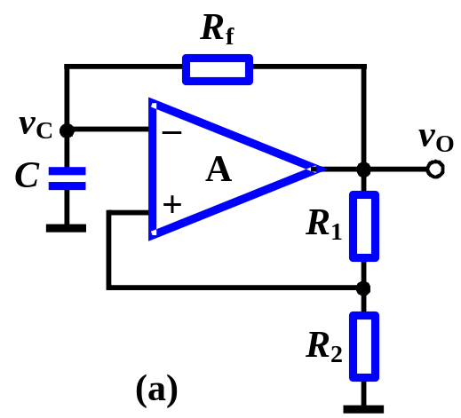
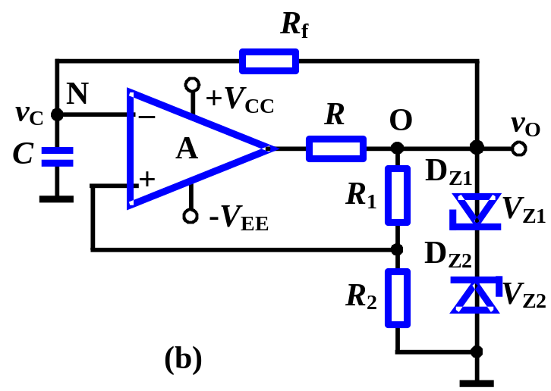
15.4.1 Schmitt Trigger Oscillator
1. Schmitt Trigger Oscillator
RC circuit
Schmitt trigger
Limiting resistor
2. Square-Wave Generator
Limiter network

Slide 6
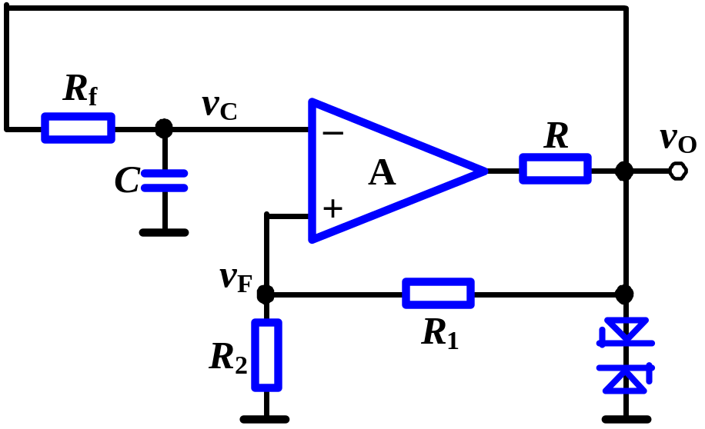
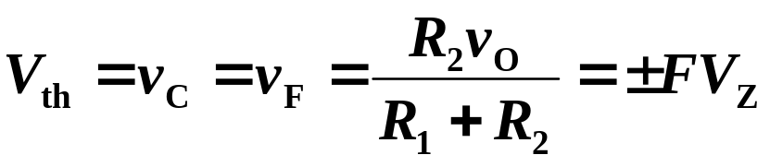
2. Operating
Assume v_{O} = +V_{Z} （or -V_{Z}）
v_{C} = 0
v_{F} = +FV_{Z}
when v_{C} > v_{F}
v_{O} ↓
v_{O} = +V_{Z}
R→C charge
v_{C} ↑
Form a circle
v_{C} ↓
R→C discharge
v_{O} = −V_{Z}
v_{O} ↑
when v_{C} < v_{F}
v_{F} = -FV_{Z}

Slide 7

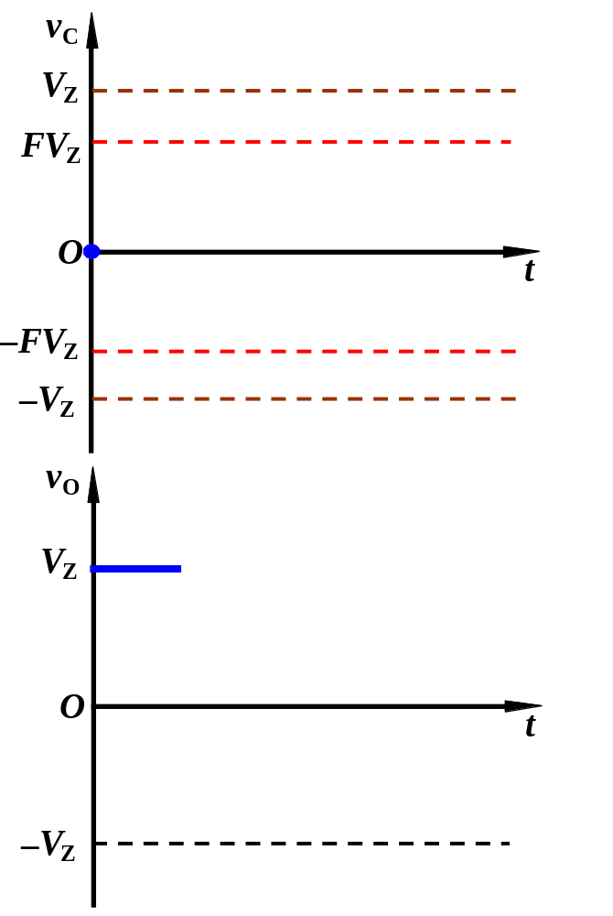
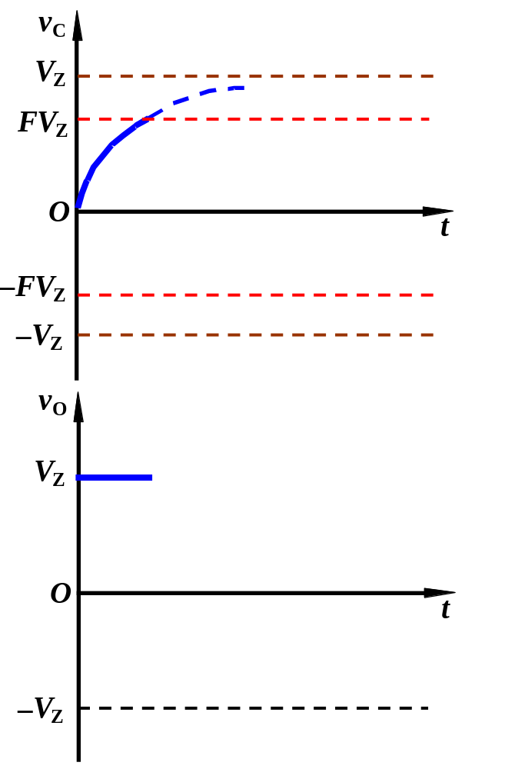
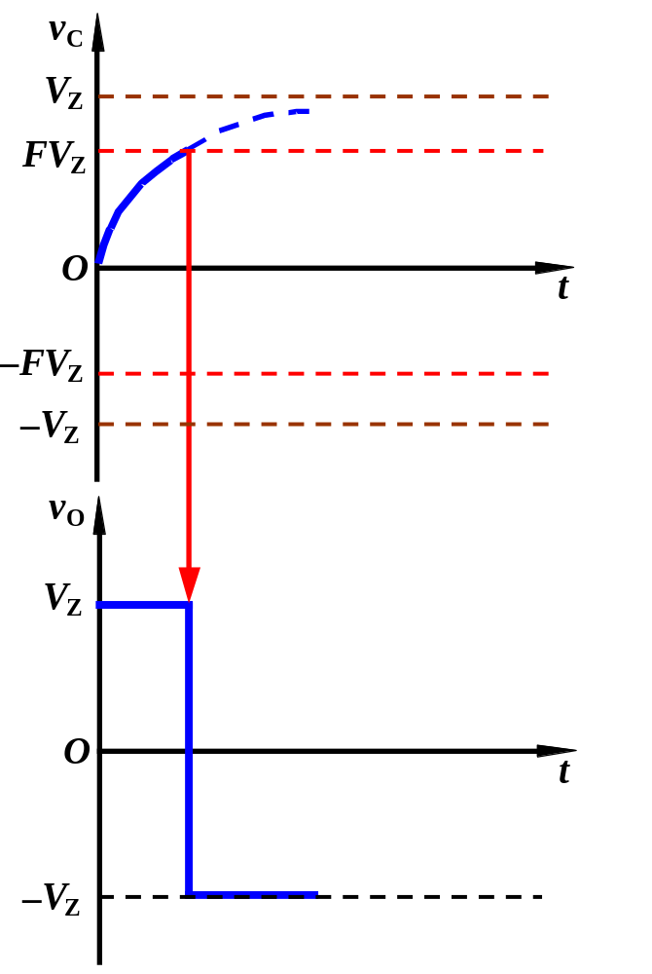
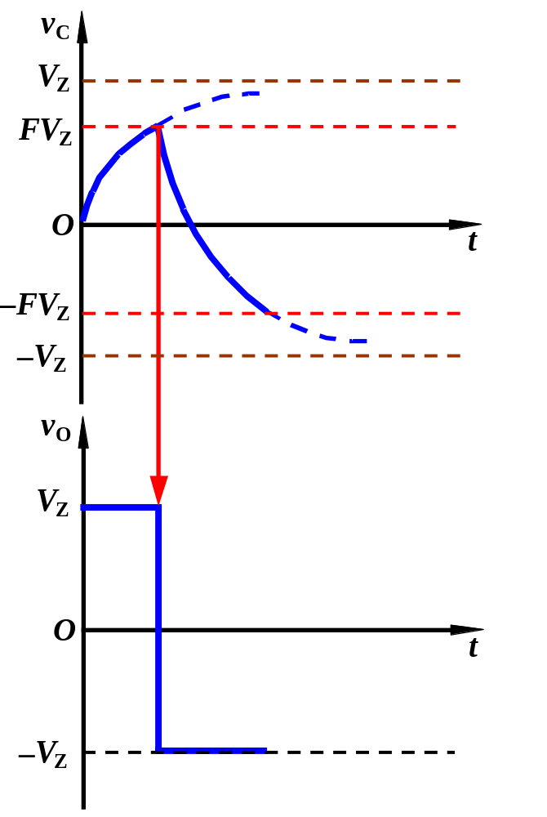
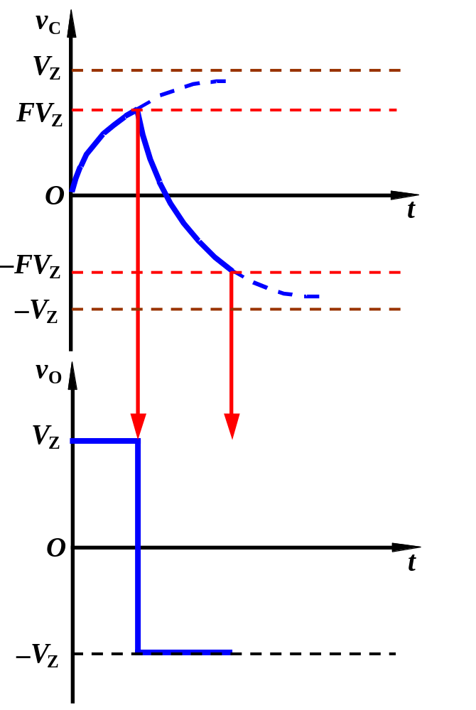
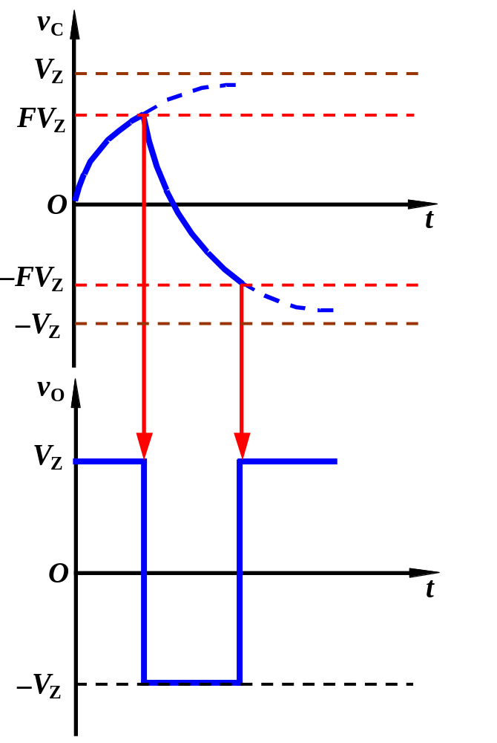
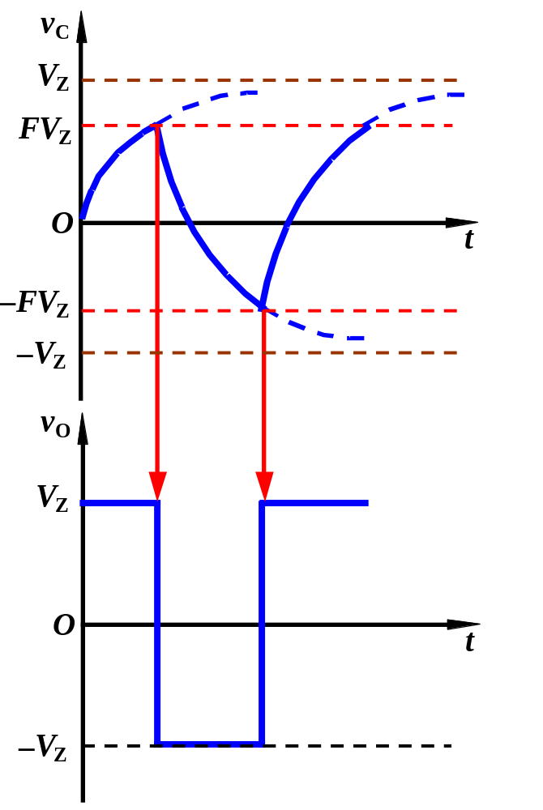
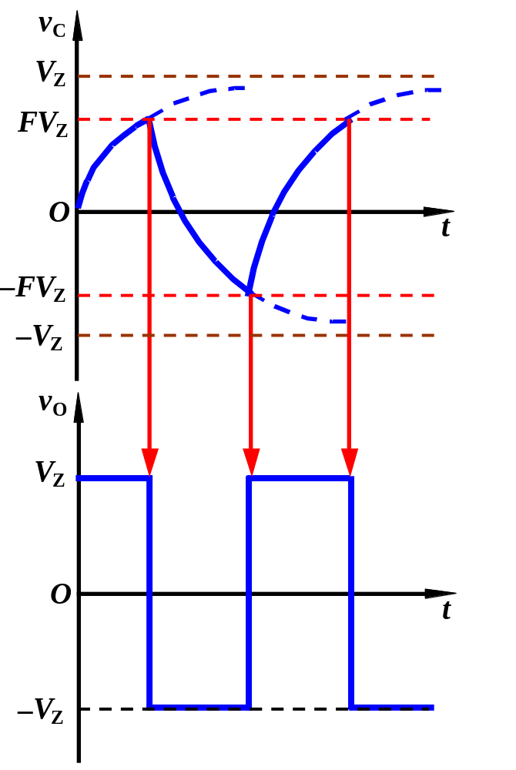
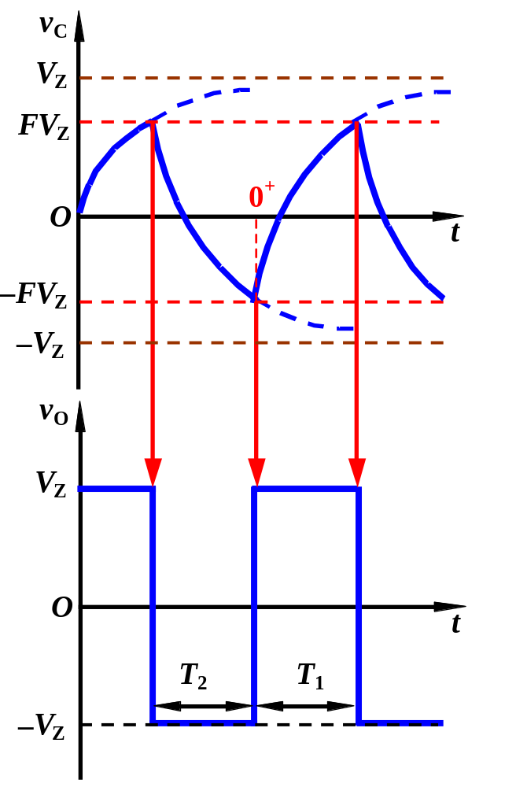
2. Operating
How to change duty cycle？

Slide 8
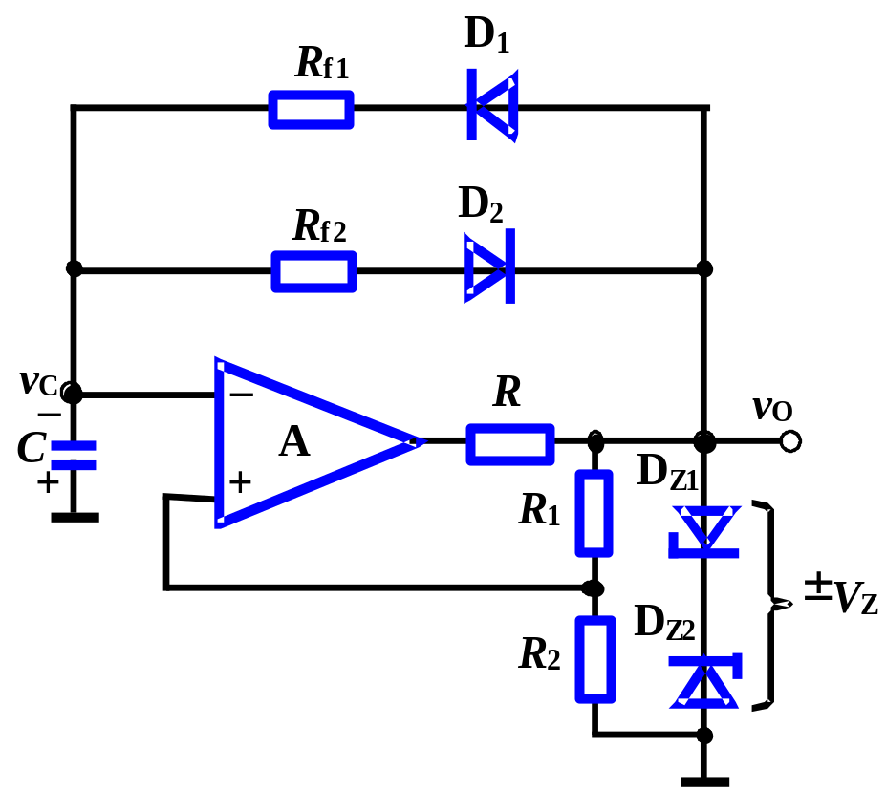
3. Duty Cycle
The duty cycle of square-wave is 50%. When charging and discharging paths are different, the duty cycle can be varied.

Slide 9
Question: can generate Square wave and triangle wave at the same time?

Slide 10
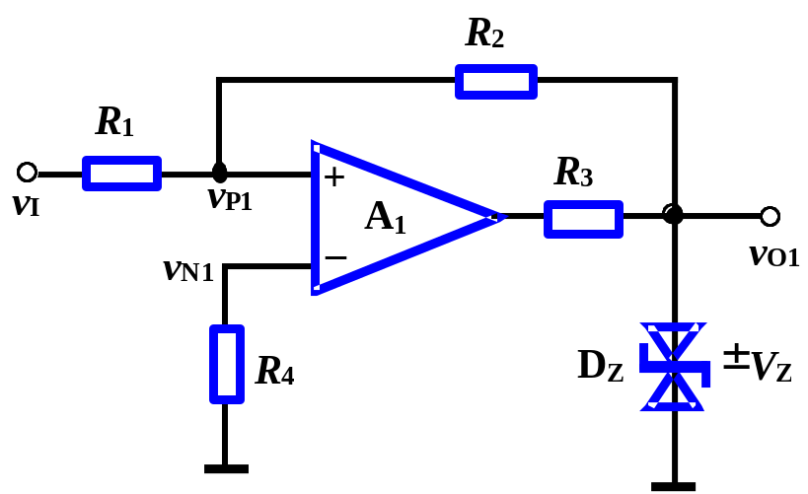
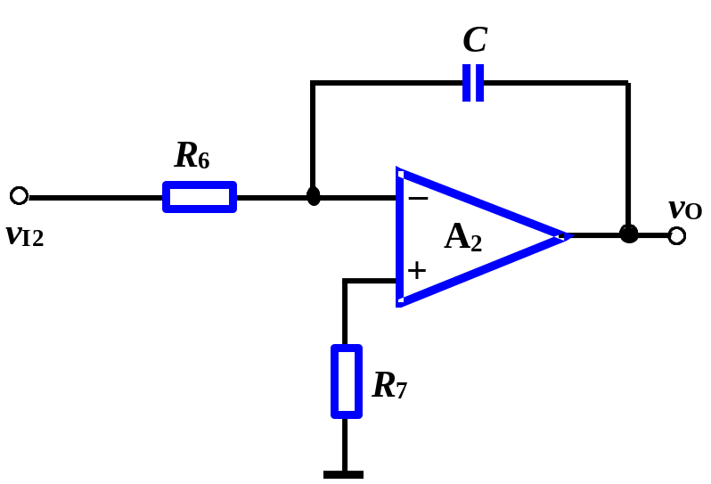
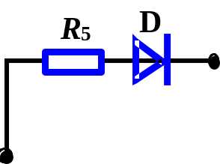
Sawtooth-Wave Generator
Different charge and discharge paths
1. Structure
Noninverting Schmitt Trigger
Integrator

Slide 11
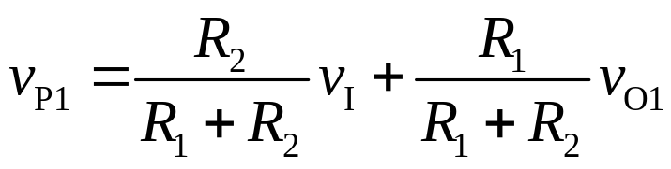
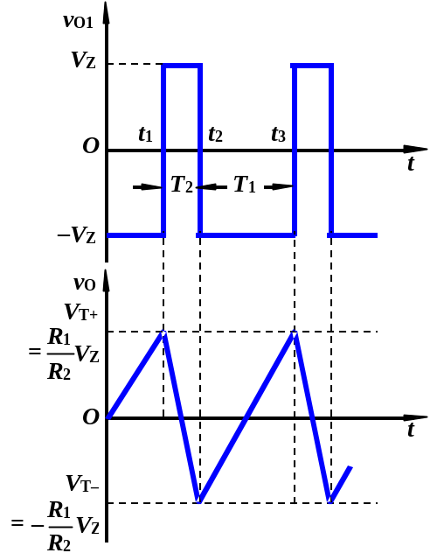
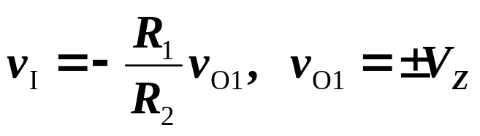
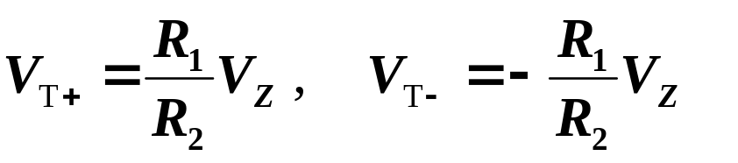
Sawtooth-Wave Generator
When circuit switches v_{P1}=v_{N1}=0,

Slide 12
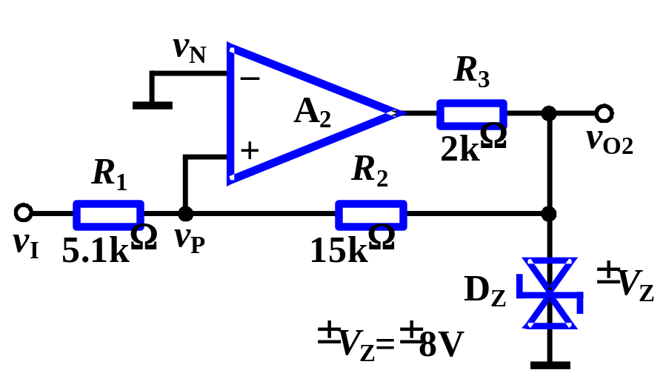
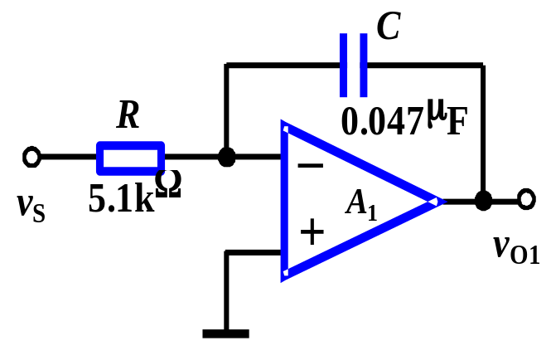
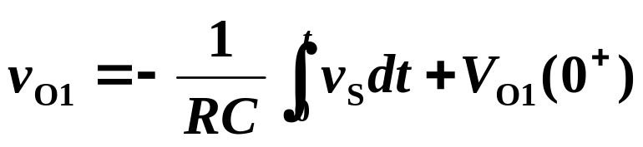
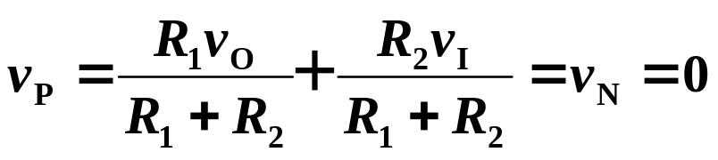
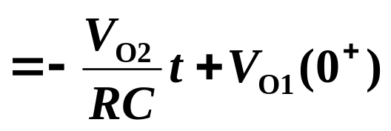
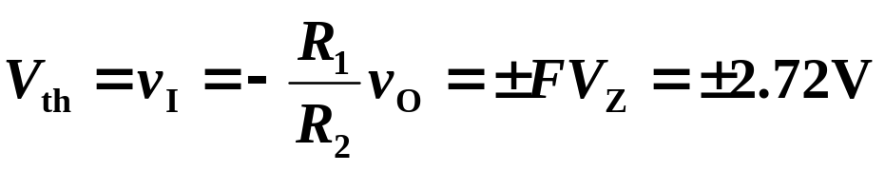
Find out the period of oscillation and sketch the wave of v_{O1}、v_{O}.
integrator
Schmitt Triggers

Slide 13

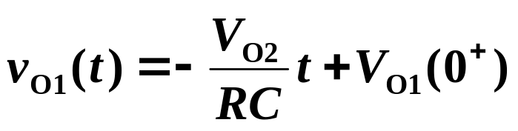
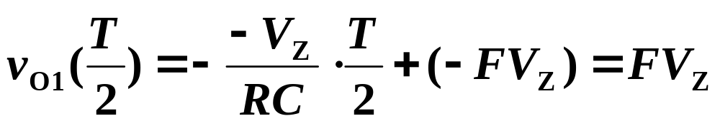
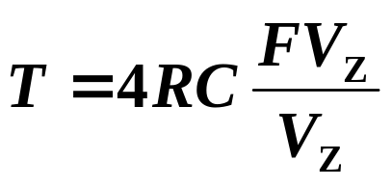
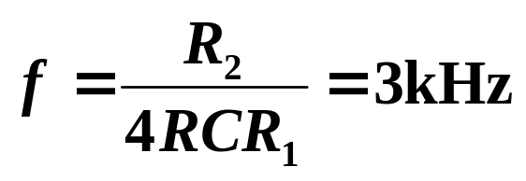
Find out the period of oscillation and sketch the wave of v_{O1}、v_{O}.
v_{O2}
t
0
v_{O1}
t
0

Slide 14
Questions
and
Answers

